Slide 1


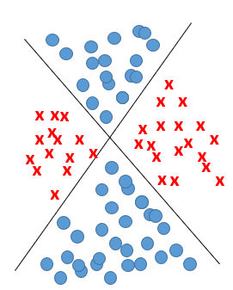
Multilayer Neural Network
non linearly separable problem
2023/2024
Abdelwahab Naji - Enseignant chercheur
Abdelwahab.naji@gmail.com
ENSAO, Université Mohamed premier - Oujda
https://www.youtube.com/c/AbdelwahabNaji

Slide 2
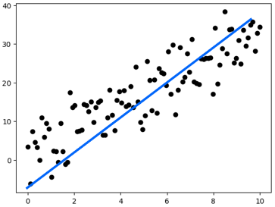
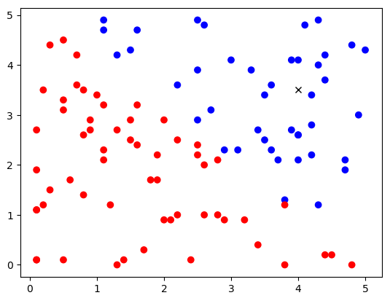
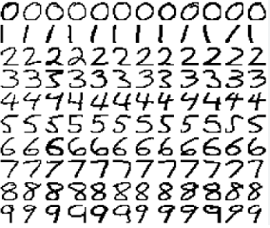
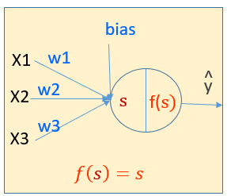
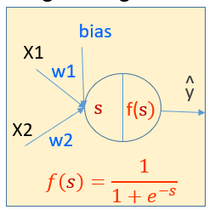
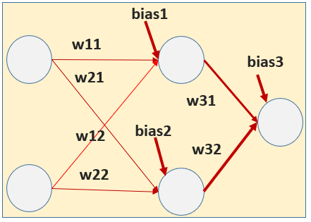
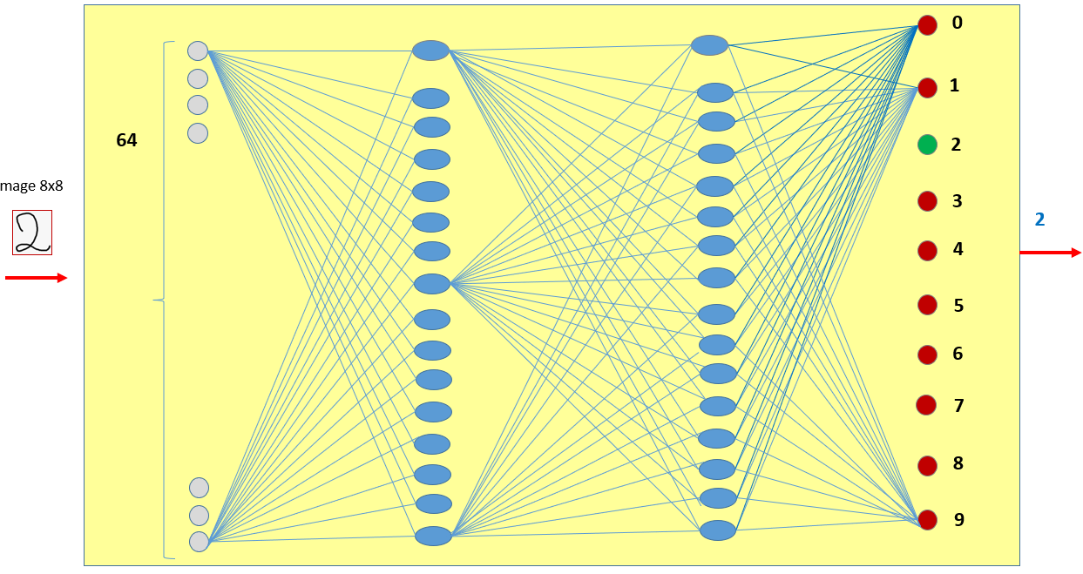
Neural Network for Supervised Learning
3
4
5
1
2
Multi Variate Linear Regression Problem
Linearly Separable problem
Non Linearly Separable problem:
Complex classification problem
Simple Linear Regression Problem
TV | Radio | Np | CA
230.1 | 37.8 | 69.2 | 22,1
44.5 | 39.3 | 45.1 | 10,4
17.2 | 45.9 | 69.3 | 9,3
…
199.8 | 2.6 | 21.2 | 10,6
Random point cloud
Advertising problem
Red or Blue?
XOR Problem
Hand Written digits Problem

Slide 3
Neural Network – One Neurone
Simple Regression Problem
bias
w1
output
X1
ws=bias+w1*X1
linear(z)=z

Slide 4
Neural Network – One Neurone
Simple Classification Problem
bias
w1
output
X1
ws=bias+w1*X1+w2.x2
sigmoid(z)=1/1+exp(-z)
w2
X1

Slide 5
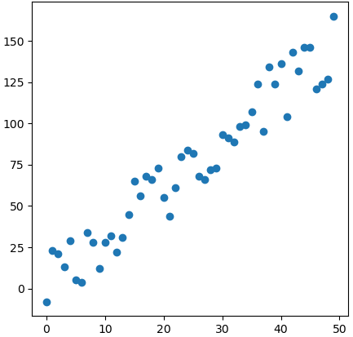
1
Simple Regression problem
plt.figure(figsize=(5, 5))
plt.scatter(X, y)
plt.show()
#Librairies
import matplotlib.pyplot as plt
from random import seed
from random import randrange
import numpy as np
np.random.seed(0)
def f(X):
return 1+3*X
def generateData (n):
X=np.array([i for i in range(n)])
y_model=f(X)
y =np.array([i+randrange(-20,20) for i in y_model])
return X,y_model,y
n_samples = 50
X,y_model,y=generateData(n_samples)

Slide 6
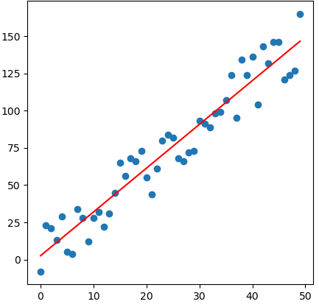
def fit(X,y):
lr=0.001
epochs=10000
bias=0.5
w1=0.5
n=len(y)
for i in range(epochs):
py=bias+w1*X
dbias=-(2/n)*sum(y-py)
print(epochs,"----------------->",w1," , ",bias)
dw1=-(2/n)*sum(X*(y-py))
w1=w1-dw1*lr
bias=bias-dbias*lr
return bias,w1
bias,w1=fit(X, y)
def predict(X):
return bias+w1*X
predicted_y=predict(X)
plt.figure(figsize=(5, 5))
plt.title("Simple Regression Model)", size=16)
plt.scatter(X, y)
plt.plot(X, predicted_y, c="red")
plt.show()

Slide 7
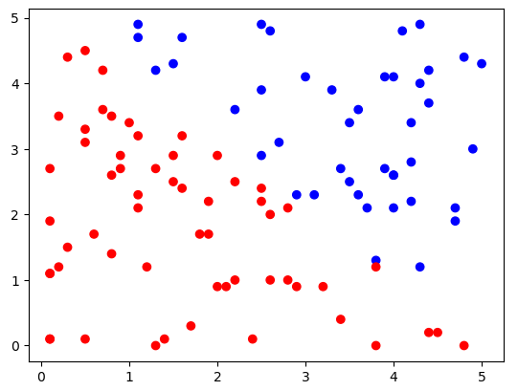
import matplotlib.pyplot as plt
import numpy as np
import matplotlib.colors as clr
2
Simple classification problem Linearly Separable
def f(x):
return -x+5
L=generateData(100)
L=np.array(L)
X=L[:,0]
y=L[:,1]
C=L[:,2]
# generate random floating point values
from random import seed
from random import random
# seed random number generator
def generateData(n):
seed(1)
min=0
max=5
# generate random numbers between 0-1
L=[]
for _ in range(n):
valueX = random()
scaledvalueX = min + (valueX * (max - min))
valueY = random()
scaledvalueY = min + (valueY * (max - min))
x=round(scaledvalueX,1)
y=round(scaledvalueY,1)
y0=f(x)
cl=0
if(y>y0):
cl=1
L.append([x,y,cl])
return L
colors = ['red','blue']
plt.scatter(L[:,0],L[:,1],c=L[:,2],cmap=clr.ListedColormap(colors))

Slide 8
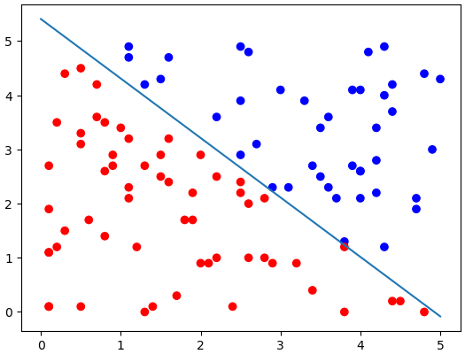
def fit(X,y):
#initialisation
n=len(y)
bias=0.5
w1=0.5
w2=0.5
epochs=5000#hyperparamter
lr=0.01 #hyperparameter
#learning
for i in range(epochs):
y=L[:,2]
ws=bias+w1*L[:,0]+w2*L[:,1]
py=sigmoid(ws)
#update
dbias=-(2/n)*sum(y-py)
dw1=-(2/n)*sum(L[:,0]*(y-py))
dw2=-(2/n)*sum(L[:,1]*(y-py))
bias=bias-dbias*lr
w1=w1-dw1*lr
w2=w2-dw2*lr
return bias,w1,w2
def getY(x,bias,w1,w2):
return -w1/w2*x-bias/w2
x1=0
x2=5
y1=getY(x1,bias,w1,w2)
y2=getY(x2,bias,w1,w2)
colors = ['red','blue']
plt.scatter(L[:,0],L[:,1],c=L[:,2],cmap=clr.ListedColormap(colors))
#plt.plot([x1,x2],[y1,y2])
plt.plot([x1,x2],[y1,y2])
bias,w1,w2=fit(X,y)

Slide 9
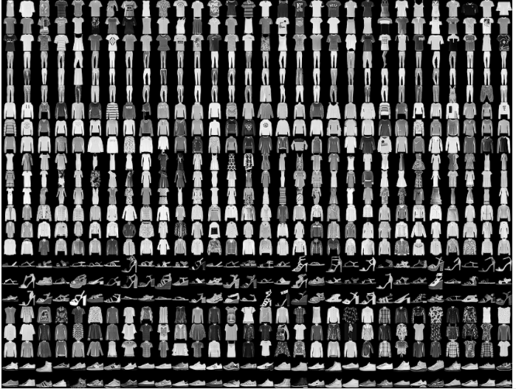
3
4
Complex classification problem non Linearly Separable
Images classification
X2
X1

Slide 10
Mise en œuvre de Neural Network
NN: Multi – Layer
Présentation du problème non linéairement séparable
Implémentation du Problème non linéairement séparable (avec tensorflow, keras )
Exemple 1: simple XOR problem
Générer les données
Créer et entrainer un multilayer neuralnetwork
Exemple 2: general XOR problem
Générer les données
Créer et entrainer un multilayer neuralnetwork
Exemple 3: fashion classification problem
Exemple 4: hand written digits classification problem
Implémentation from scratch
Exemple: fashion classification problem

Slide 11
Problem
Séparation de AND, OR,NAND, NOR, XOR

Slide 12
F | T
F | T
F | F
On peut avoir une séparation linéaire
T
1
And
F
x1
AND
0
output
0
1
x2
On peut avoir une séparation linéaire
F | T
T | T
F | T
T
1
OR
x1
F
OR
0
output
x2
0
1
F | T
T | F
F | T
T
1
On ne peut pas avoir une séparation linéaire
XOR
F
0
0
1

Slide 13
Séparation de X0R
F | T
T | F
F | T
T
1
On peut utiliser plus qu’une ligne pour faire la séparation
XOR
F
0
0
1
1
0
0
1
XOR = (!AND) and (OR)

Slide 14
XOR = (!AND) and (OR)
x1
T
F
T
F
F
! AND
T
! AND
T
! AND
T
! AND
x2
T
F
F
T
x1
T
F
T
F
T
OR
F
OR
T
OR
T
OR
x2
T
F
F
T
x1
F
F
T
T
T
F
XOR
F
T
XOR
XOR
XOR
x2
T
T
F
F

Slide 15
x1
F
F
T
T
T
F
XOR
F
T
XOR
XOR
XOR
x2
T
T
F
F
T
! AND
F
! AND
T
T
! AND
F
F
! AND
T
T
T
AND
T
AND
F
AND
F
AND
T
T
T
F
F
OR
T
OR
T
OR
F
OR
X1
! AND
AND
y
X2
OR

Slide 16
Utiliser keras pour créer un réseau de neurone avec plusieurs neurones (couche, layer)
Ce qu’il faut connaitre:
Comment créer un multilayer neural network (en général)?
Découvrir les éléments du neural network créé: coeficients, bias

Slide 17
Neural Network Model et ses paramètres
Architecture
Créer le modèle
Créer une couche et l’ajouter au modèle
Paramètres d’une couche

Slide 18
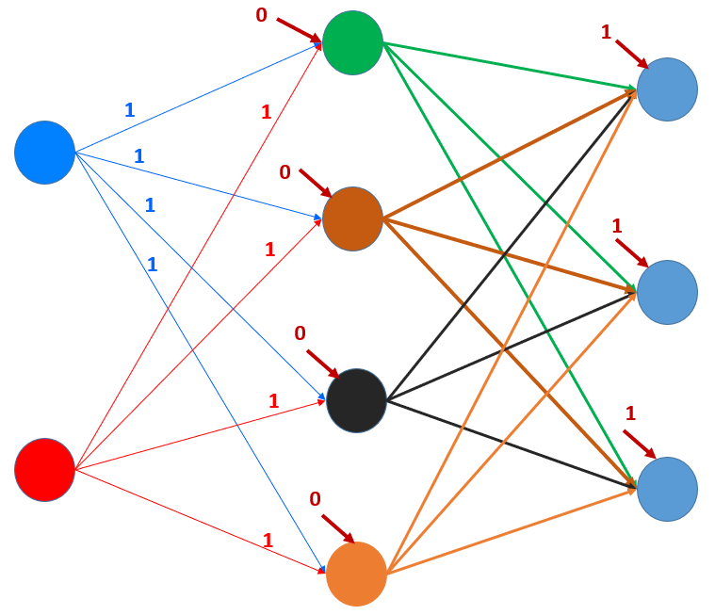
Réseau de neurones de trois couches
HIDDEN LAYER
OUTPUT LAYER
INPUT LAYER

Slide 19
Model et ses paramètres
from keras.models import Sequential
from keras.layers import Flatten, Dense, Activation
model = Sequential()
#input_layer=Flatten(input_shape=[2, 1])
#model.add(input_layer)
hidden_layer=Dense(4, input_dim=2,kernel_initializer='ones',bias_initializer='zeros')
model.add(hidden_layer)
output_layer=Dense(3, kernel_initializer='random_uniform',bias_initializer='ones')
model.add(output_layer)
print(model.summary())
print(model.get_weights()) #initial weights
[array([[1., 1., 1., 1.],[1., 1., 1., 1.]], dtype=float32),
array([0., 0., 0., 0.], dtype=float32),
array([[-0.03575971, -0.02119735, 0.01558626],
[ 0.04222678, -0.04578313, 0.0360521 ],
[-0.02753322, 0.00745941, -0.04211374],
[-0.04299896, -0.04190966, 0.02975568]], dtype=float32),
array([1., 1., 1.], dtype=float32)]
model.compile(loss="categorial_crossentropy",
optimizer="adam",
metrics=["accuracy"])

Slide 20
Revenons à
XOR Problem (simple XOR)
1
0
Les étapes à suivre pour créer le modèle
0
1
XOR = (!AND) and (OR)
Data
Model
Create the model, compile the model: keras, tensorflow
Optimizer function: sgd, adam
Loss function: binary_crossentropy
Train the model
Parameters
Prediction
Evaluation
X1
! AND
AND
y
X2
OR
0
1
0
1
-0.033
1
0
0.041
1

Slide 21
1. Dataset
X=np.array([[0,0],[0,1],[1,0],[1,1]])
y = np.array(np.logical_xor(X[:, 0] > 0, X[:, 1] > 0), dtype=int)

Slide 22
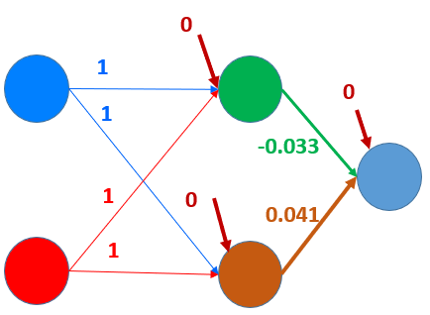
2. Model
from keras.models import Sequential
from keras.layers import Activation, Dense,Flatten
model = Sequential()
#input_layer = Flatten(input_shape=[2,1])
hidden_layer = Dense(2,input_dim=2, kernel_initializer='ones',bias_initializer='zeros’, activation=‘relu’)
output_layer = Dense(1,kernel_initializer='random_uniform',bias_initializer='zeros’, activation=‘sigmoid’)
#model.add(input_layer)
model.add(hidden_layer)
model.add(output_layer)
coef=model.get_weights()
print(coef)
#opt=tf.keras.optimizers.SGD(learning_rate=0.001)
model.compile(loss='binary_crossentropy',optimizer='sgd',metrics=['accuracy’])
[array([[1., 1.], [1., 1.]], dtype=float32), array([0., 0.], dtype=float32),
array([[-0.03330588], [ 0.04190588]], dtype=float32), array([0.], dtype=float32)]
model.fit(X,y,epochs=1000)
print(model.get_weights())
print(model.predict(X)

Slide 23
Optimizers
Batch Gradient Descent
Stochastic Gradient Descent
Mini-Batch Gradient Descent
Momentum Gradient Descent
Adagrad
RMSProp
ADAM
…
https://induraj2020.medium.com/different-variants-of-gradient-descent-6854d3118c4c
https://towardsdatascience.com/stochastic-gradient-descent-clearly-explained-53d239905d31
https://realpython.com/gradient-descent-algorithm-python/
https://towardsdatascience.com/7-tips-to-choose-the-best-optimizer-47bb9c1219e

Slide 24
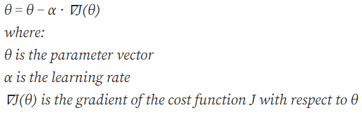
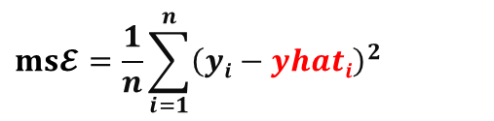
Batch Gradient Descent - recall
Formulation used in litterature
def fit(X,y):
learning_rate=0.001
epochs=10000
n=len(y)
W=np.array(np.zeros(X.shape[1]))
bias=0
for k in range(epochs):
yhat=bias+np.dot(X,W)
#mean squared function as a cost function
dbias=-(2/n)*np.sum(y-yhat)
bias=bias-dbias* learning_rate
dW= (2/n)* np.dot(X.T,(y-yhat))
W=W-dW* learning_rate
return bias,W
Pour la mise à jour des poids, à chaque itération le dataset est utilisée entièrement
Le nombre de dérivés à calculer est énorme (si d est grand)
Convergence lente dans le cas de large dataset
N° | X1 | … | xd
1
2
i
n
$$ms𝓔=\frac{1}{n}\sum_{i=1}^{n}{{\left(yi−yhati\right)}^{2}}$$

Slide 25
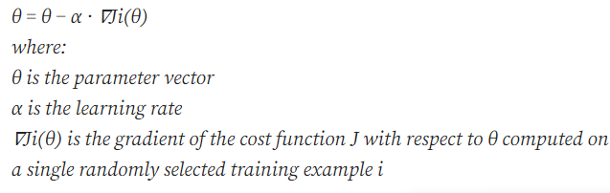
Stochastic Gradient Descent
def fit(X,y):
learning_rate=0.001
epochs=10000
n=len(y)
W=np.array(np.zeros(X.shape[1]))
bias=0
for k in range(epochs):
yhat=bias+np.dot(X,W)
#mean squared function as a cost function
dbias=-(2/n)*np.sum(y-yhat)
bias=bias-dbias* learning_rate
dW=??-(2/n)* np.dot(X.T,(y-yhat))
W=W-dW* learning_rate
return bias,W
Formulation used in litterature
N° | X1 | … | xd
1
2
i
n
updates the model parameters for each training example in the dataset selected randomly
can lead to faster convergence because the updates are more frequent and noisy
but it can also result in more oscillations in the cost function due to the randomness of the updates.

Slide 26
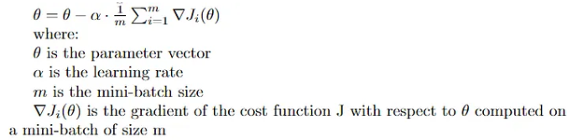
Mini-Batch Gradient Descent
def fit(X,y):
learning_rate=0.001
epochs=10000
n=len(y)
W=np.array(np.zeros(X.shape[1]))
bias=0
for k in range(epochs):
yhat=bias+np.dot(X,W)
#mean squared function as a cost function
dbias=-(2/n)*np.sum(y-yhat)
bias=bias-dbias* learning_rate
dW=??-(2/n)* np.dot(X.T,(y-yhat))
W=W-dW* learning_rate
return bias,W
Formulation used in litterature
N° | X1 | … | xd
1
2
..
K1
…
K2
..
n
It is a compromise between batch gradient descent and stochastic gradient descent
the gradients are computed on a small random subset of the training dataset: mini-batch
This reduces the computational cost of the algorithm compared to batch gradient descent
Also reducing the variance of the updates compared to SGD.
It is widely used in deep learning because it strikes a good balance between convergence speed and stability.
m

Slide 27
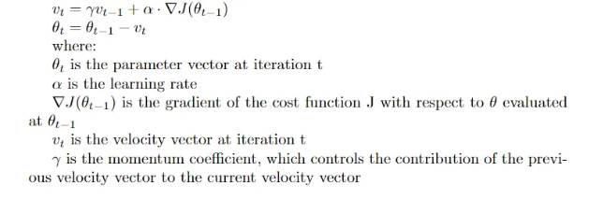
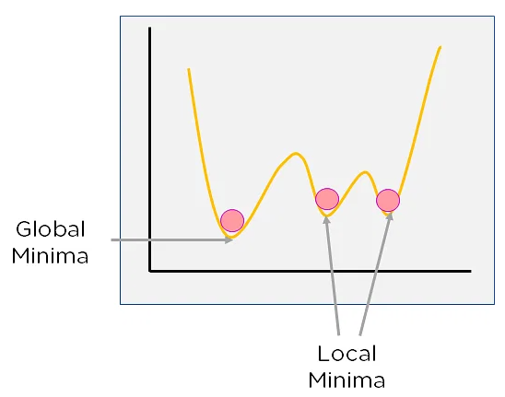
Momentum Gradient Descent
Formulation used in litterature
def fit(X,y):
learning_rate=0.001
epochs=10000
n=len(y)
W=np.array(np.zeros(X.shape[1]))
bias=0
for k in range(epochs):
yhat=bias+np.dot(X,W)
#mean squared function as a cost function
dbias=-(2/n)*np.sum(y-yhat)
bias=bias-dbias* learning_rate
dW=??-(2/n)* np.dot(X.T,(y-yhat))
W=W-dW* learning_rate
return bias,W
N° | X1 | … | xd
1
2
..
K1
…
K2
..
n
adds a momentum term to the update rule.
The momentum term accumulates the gradient values over time and dampens the oscillations in the cost function, leading to faster convergence.
This is particularly useful in cases where the cost function has a lot of noise or curvature, which can cause traditional gradient descent to get stuck in local minima.

Slide 28
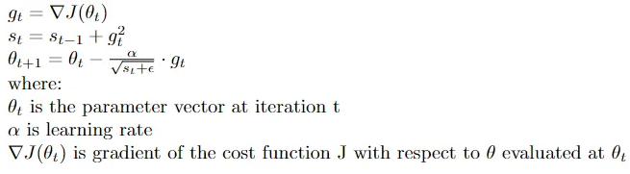
Adagrad
def fit(X,y):
learning_rate=0.001
epochs=10000
n=len(y)
W=np.array(np.zeros(X.shape[1]))
bias=0
for k in range(epochs):
yhat=bias+np.dot(X,W)
#mean squared function as a cost function
dbias=-(2/n)*np.sum(y-yhat)
bias=bias-dbias* learning_rate
dW=??-(2/n)* np.dot(X.T,(y-yhat))
W=W-dW* learning_rate
return bias,W
Formulation used in litterature
N° | X1 | … | xd
1
2
..
K1
…
K2
..
n
adapts the learning rate for each parameter based on its historical gradient values.
Parameters with large gradients have their learning rates reduced, while parameters with small gradients have their learning rates increased.
This helps to normalize the updates and can be useful in cases where the cost function has a lot of curvature or different scales of gradients.

Slide 29
RMSProp
def fit(X,y):
learning_rate=0.001
epochs=10000
n=len(y)
W=np.array(np.zeros(X.shape[1]))
bias=0
for k in range(epochs):
yhat=bias+np.dot(X,W)
#mean squared function as a cost function
dbias=-(2/n)*np.sum(y-yhat)
bias=bias-dbias* learning_rate
dW=??-(2/n)* np.dot(X.T,(y-yhat))
W=W-dW* learning_rate
return bias,W
N° | X1 | … | xd
1
2
..
K1
…
K2
..
n
adapts the learning rate for each parameter, but instead of using the historical gradient values, it uses a moving average of the squared gradient values
This helps to reduce the learning rate for parameters that have large squared gradient values, which can cause the algorithm to oscillate or diverge.

Slide 30
Adam
def fit(X,y):
learning_rate=0.001
epochs=10000
n=len(y)
W=np.array(np.zeros(X.shape[1]))
bias=0
for k in range(epochs):
yhat=bias+np.dot(X,W)
#mean squared function as a cost function
dbias=-(2/n)*np.sum(y-yhat)
bias=bias-dbias* learning_rate
dW=??-(2/n)* np.dot(X.T,(y-yhat))
W=W-dW* learning_rate
return bias,W
N° | X1 | … | xd
1
2
..
K1
…
K2
..
n
combines the ideas of Adagrad and RMSProp.
It adapts the learning rate for each parameter based on the historical gradient values and also uses a moving average of the gradient values to compute the momentum term.
Adam is one of the most widely used optimization algorithms in deep learning because it is efficient, stable,
and robust to different types of cost functions and datasets.

Slide 31
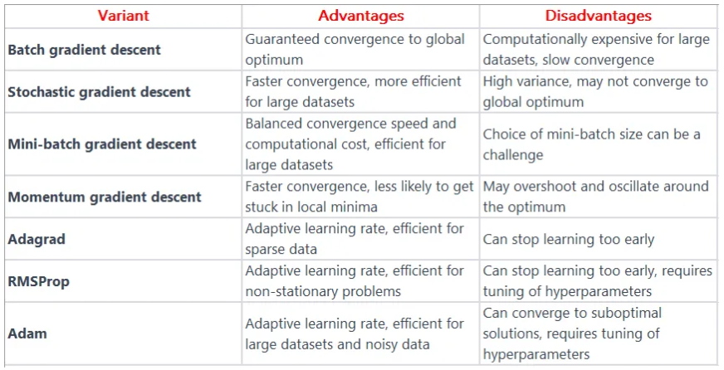
Comparaisons

Slide 32
bias1
w11
bias3
w21
w31
w12
bias2
w32
w22

Slide 33
2. Model (avec une autre fonction d’activation)
from keras.layers import LeakyReLU
act = LeakyReLU(alpha = 0.3)
model = Sequential()
hidden_layer = Dense(2,input_dim=2, kernel_initializer='ones',bias_initializer='zeros',activation=act)
model.add(hidden_layer)
output_layer = Dense(1,kernel_initializer='random_uniform',bias_initializer='zeros',activation='sigmoid')
model.add(output_layer)
model.add(hidden_layer)
model.add(output_layer)
coef=model.get_weights()
print(coef)
model.compile(loss='binary_crossentropy',optimizer='adam',metrics=['accuracy'])
model.fit(X,y,epochs=1000)
print(model.get_weights())
print(model.predict(X))

